Slide 1
Enhancing Parent Involvement in NC-CCSS for K-2 Mathematics
Presented By: 2014 REU Math Team

Slide 2
Members
Deanna Mallard
Mississippi Valley State University
Tayla Frizell
Mississippi Valley State University
Nyjah Grant
Longwood University

Slide 3
Mentors
Dr. Darnell Johnson
Elizabeth City State University
Dr. Ervin Howard
Elizabeth City State University

Slide 4
Overview
Abstract Parent Workshop
Methodology Focus Questions
Bloom’s Taxonomy Pre and Post Surveys
5E Cycle Model; Lesson Plan Results
Math FUN Conclusion
NXT LEGO Robotics Future Work
Parent Workshop Flyer Acknowledgements
Workshop Template Questions

Slide 5
Abstract
In this study, the 2014 REU math team developed and provided a workshop that assisted parents in understanding the North Carolina Common Core State Standards for K-2 Mathematics to assist with student homework assignments. Parent involvement is defined as parent participating in the educational processes and experiences of their children. A chi-square analysis was used to analyze data collected from the pre survey and the post survey administered to participants in the workshop. The study revealed all of the individual components of parent involvement were positively and significantly related to educational goals. The study identified various aspects of parent involvement that yielded statistically significant results in affirming that parent involvement attributed to urban student achievement. These findings were particularly helpful for indicating which kinds of parent involvement influenced academic success. Most notably, parent expectations and styles demonstrated a strong relationship with scholastic outcomes. Parent expectations and styles created an educationally oriented ambience that established an understanding of the certain level of support the child needed to succeed academically. The REU mathematics team focused on three essential questions in this study: (1) What practices will increase parent awareness of K-2 NC-CCSS for mathematics at P. W. Moore Elementary School? (2) What methods can be used to strengthen parent skills in assisting with mathematics homework assignments at P. W. Moore Elementary School? (3) What actions can be taken to motivate parent involvement in the school improvement process focusing on mathematics at P. W. Moore Elementary School?
Key Terms— Parent Involvement, Common Core State Standards, Homework, K – 2 Mathematics

Slide 6
Methodology
In preparation for our workshop, we
Observed Kindergarten, First Grade, and Third Grade classrooms at P.W. Moore Elementary School
Constructed a lesson plan using the 5E Learning Model
Taught content related to Common Core State Standards and assigned Math Fun worksheet for homework
Introduced NXT LEGO Robotics to the students
Divided the students into three competitive teams to be monitored by one member for each team
Involved students in programming robots to complete an obstacle course designed by the REU team
Distributed 150 flyers to P.W. Moore Elementary School’s Kindergarten, First and Second grade parents
Constructed a workshop for the parents of grades K-2 at P.W. Moore Elementary School

Slide 7
Bloom’s Taxonomy
Taxonomy equals classification to classify forms and levels of learning
Suggested to not address higher levels until those below them have been covered

Slide 8
5E Learning Model

Slide 9
Lesson Plan Template

Slide 10
Math FUN

Slide 11
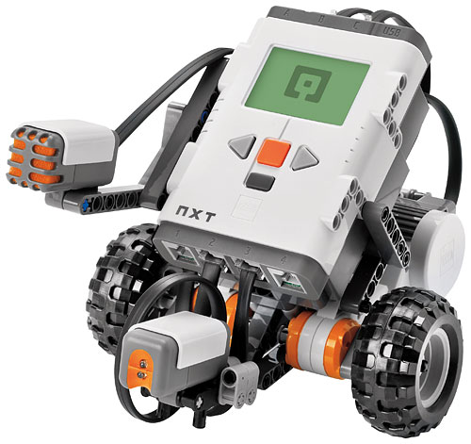
NXT LEGO Robotics
Engaged students by displaying a PowerPoint presentation on the construction and programming of the NXT Lego Robots.
Assembled team robots from NXT Lego Set with little assistance from REU members
Programmed the robots to complete an obstacle course designed by the REU team

Slide 12
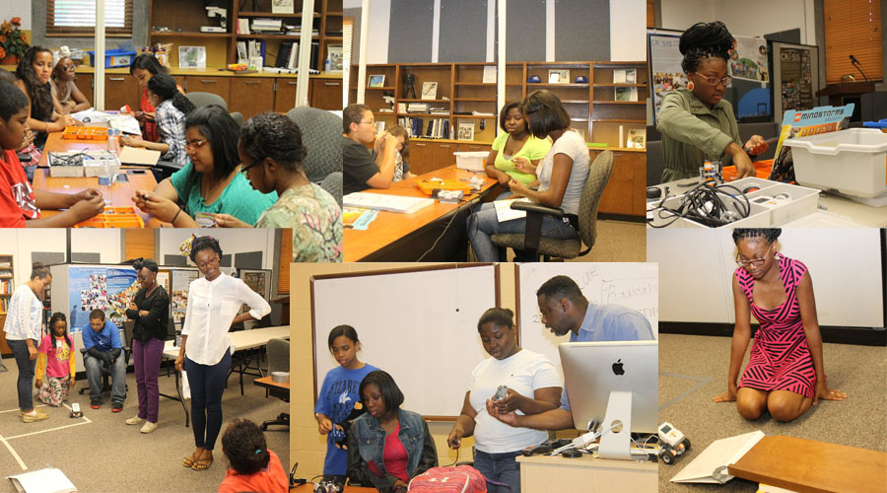
LEGO Robotics

Slide 13
Parent Workshop Flyer

Slide 14
Workshop Template

Slide 15
Parent Workshop

Slide 16
Focus Questions
(1) What practices will increase parent awareness of K-2 NC-CCSS for mathematics at P. W. Moore Elementary School?
(2) What methods can be used to strengthen parent skills in assisting with mathematics homework assignments at P. W. Moore Elementary School?
(3) What actions can be taken to motivate parent involvement in the school improvement process focusing on mathematics at P. W. Moore Elementary School?

Slide 17
Pre and Post Surveys

Slide 18
Pre-Survey Breakdown Results

Slide 19
Post-Survey Breakdown Results

Slide 20
Pre and Post Survey Comparison

Slide 21
Conclusion
The results of the surveys concluded that Parent Involvement contributes to growth in student learning. Involved parents accomplish things, including motivating and engaging their children, acquiring new knowledge and skills, and collaborating with teachers. But those accomplishments best serve their purpose when they lead their children to help improve student achievement. The workshop provided richer information on what skills and topics students are learning according to the North Carolina Common Core State Standards. Assisting parents in an understanding of the standards provided the parents with a different perspective on mathematics and understand the importance of being involved with their child’s education. Parents understood the math language by constructing different activities that can be used in the home during the workshops. Take-home activities and tips given in the parent tool kits benefited parents in assisting with student homework and learning. Most education reformers agree that improving student learning defines effective teaching. The best way to enhance parent involvement is to provide parents with guidance that is grounded in the standards and school—that is, parent use involvement to encourage student learning.

Slide 22
Future Work
The long-term goal is to build stronger parent support systems in Kindergarten, 1st and 2nd grade Mathematics in Pasquotank County Public Schools using the North Carolina Common Core State Standards. Continuation of this parent involvement workshop will be conducted at P. W. Elementary School during the 2014 – 2015 academic school year. Using the same research methods, attendance in the workshops will be enhanced by greater assistance by classroom teachers soliciting parents of Kindergarten, 1st and 2nd grade levels.

Slide 23
Acknowledgements
The members of the 2014 Research Undergraduates Mathematics Team would like to give a special thanks to Dr. Linda B. Hayden, Dr. Darnell Johnson, Dr. Stephanie D. B. Johnson, Dr. Ervin Howard, Principal Lindsay James, 2014 Teacher of the Year Mrs. Joycelyn Hinton, Mr. Michael Jefferson Jr. the REU Staff, and the staff of P.W. Moore Elementary School for guidance and assistance during this research process.

Slide 24
Questions?

